Slide 1
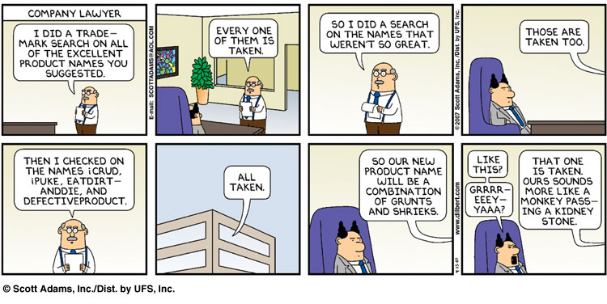
GLMs
Before we talk about GENERALIZED Linear Models (GLMS), we need to talk about GENERAL Linear Models (not-GLMs but sound really similar).

Slide 2

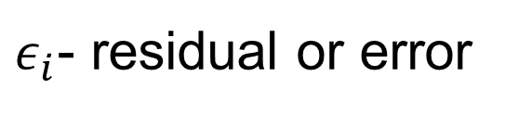

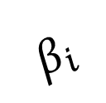


Linear Model
$ε_{i}$- residual or error
$$y_{i}$$
$$ε_{i}$$
$$β_{i}$$
$$β_{0}$$
$$x_{i}$$

Slide 3
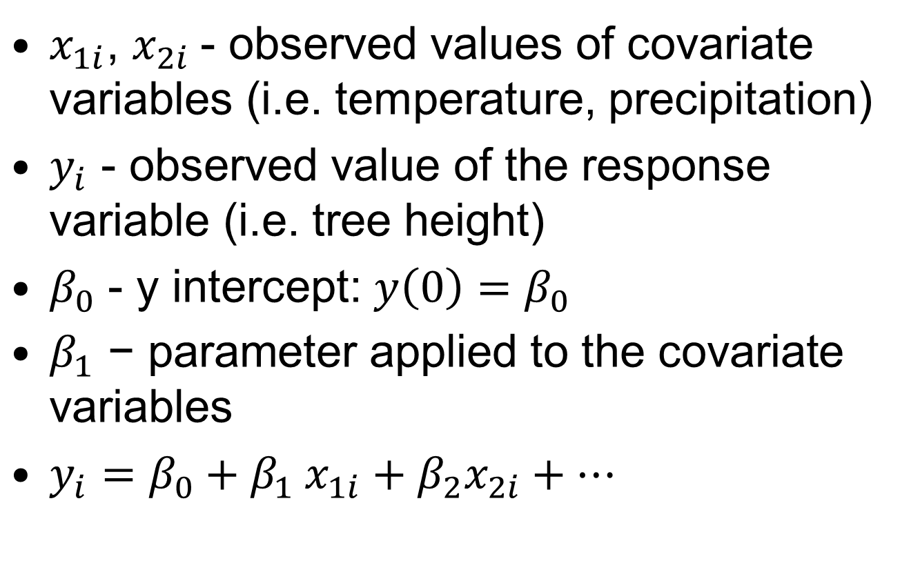
Formal Definition
$x_{1i}$, $x_{2i}$- observed values of covariate variables (i.e. temperature, precipitation)
$y_{i}$ - observed value of the response variable (i.e. tree height)
$β_{0}$ - y intercept: $y\left(0\right)=$ $β_{0}$
$β_{1}\text{ − }\text{parameter} \text{applied} \text{to} \text{the} \text{covariate} \text{variables}$
$y_{i}={β_{0}{+ β}_{1}x}_{1i}+β_{2}x_{2i}+…$

Slide 4
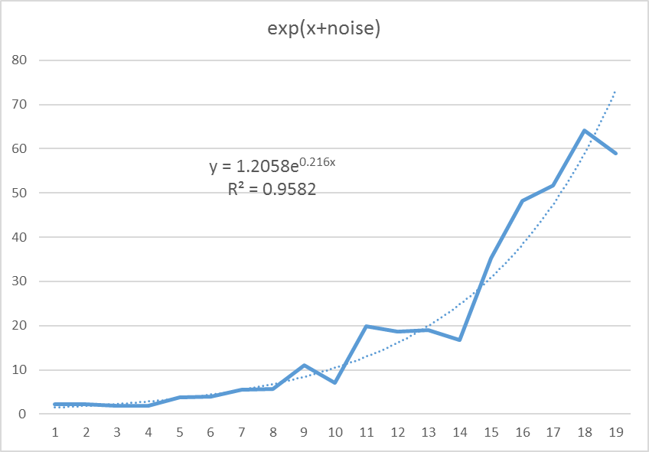
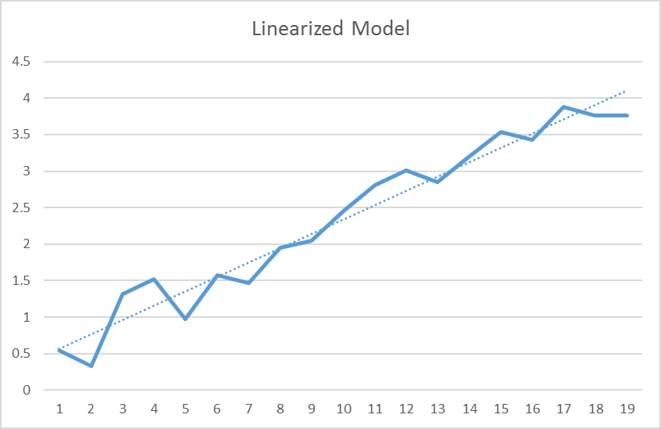

General Linear Model
$y=e^{x+ε}$
$y^{′}=1.205 e^{0.216x}$
$\ln\left(y^{′}\right)=\ln\left(1.205\right)+0.216x$
$f\left(x\right)=0.1865+0.216x$

Slide 5
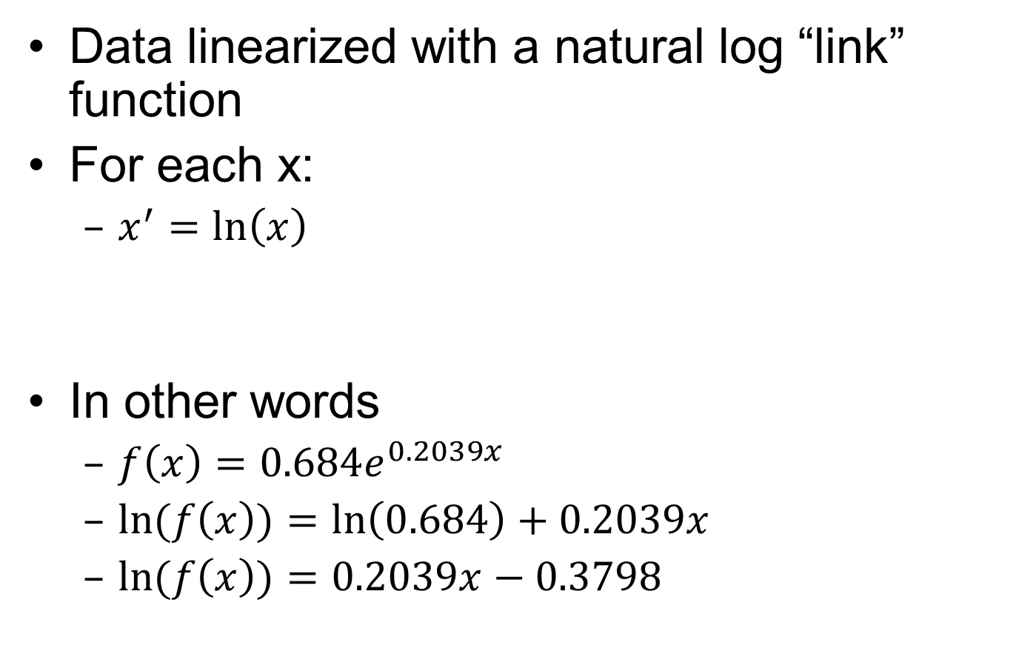
General Linear Model
Notes:
If we have a function that is an exponential, we can convert it to a linear model by taking the natural log of both sides

Slide 6
General Linear Model
Can transform the response values to linearize the relationship between the independent variables (covariates and predictors) and the response
After transformation, residuals need to be from a normal distribution and be homoscedastic
Uses linear regression (least squares)

Slide 7
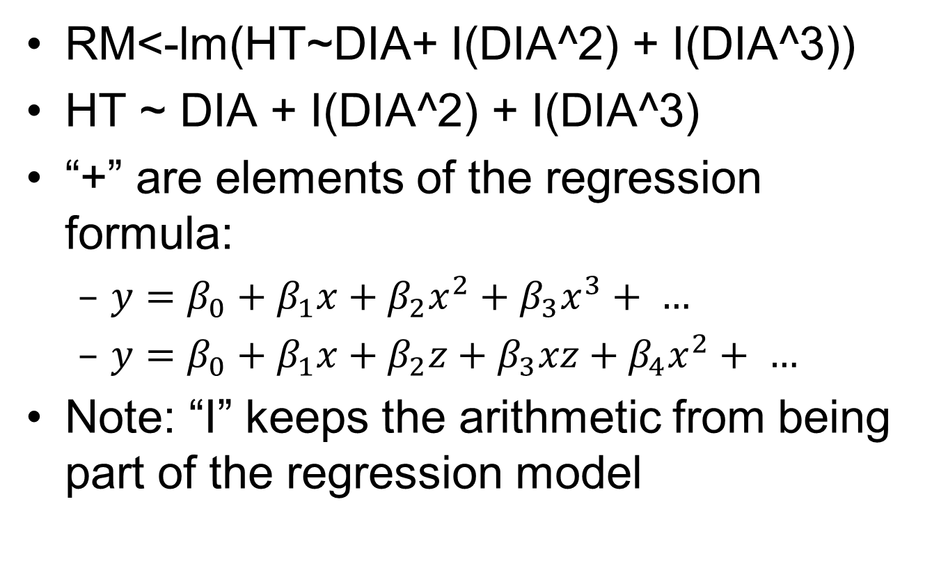
Polynomial Regression

Slide 8
Need More
Not all phenomenon follow linear response
Not all residuals are normally distributed
This leads to:
  GLMs: Single function, specified regression distribution
  GAMs: Multiple functions
  “Non-parametric” approaches: no assumptions are made about the parameters of the distribution

Slide 9
GLM
Generalized Linear Model
  Not to be confused with a general linear model
Allows a linear model to be related to the response variable via a “Link” function.
Residuals do not have to be normally distributed but do need to be from a defined probability distribution
Fit is based on maximum likelihood

Slide 10
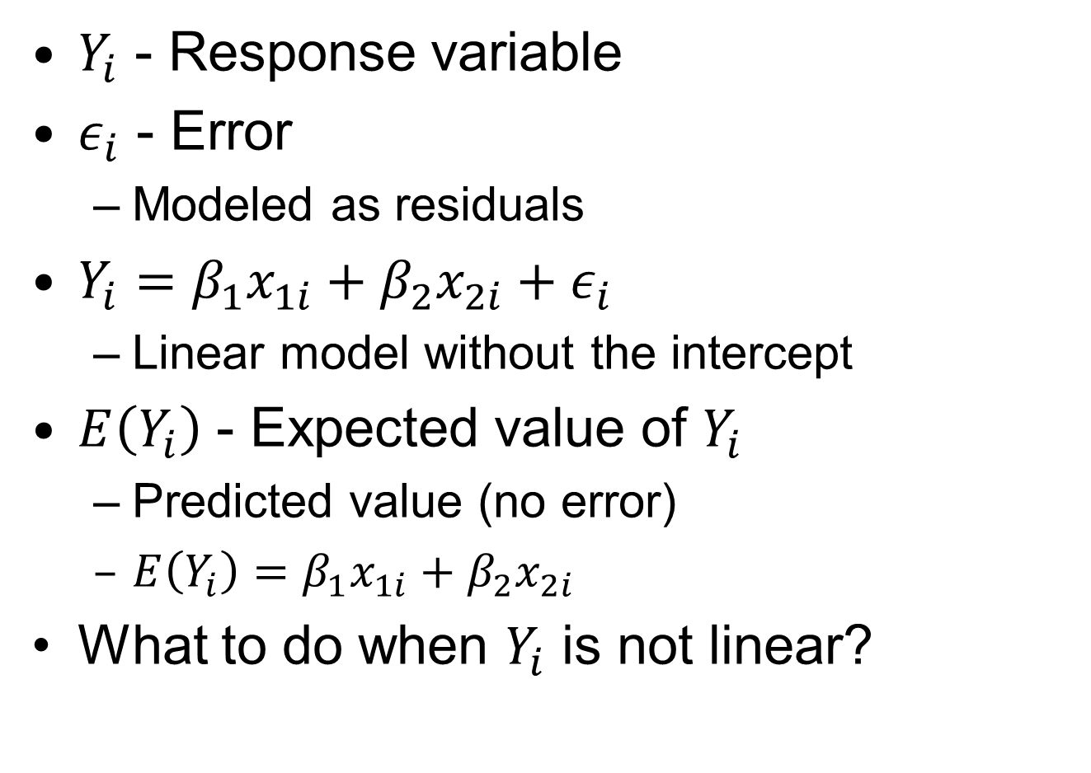
Generalized Linear Models
$Y_{i}$ - Response variable
$ε_{i}$ - Error
  Modeled as residuals
$Y_{i}={{β_{1}x}_{1i}+β_{2}x_{2i}+ε}_{i}$
  Linear model without the intercept
$E\left(Y_{i}\right)$ - Expected value of $Y_{i}$
  Predicted value (no error)
  $E\left(Y_{i}\right)$ $=$ ${β_{1}x}_{1i}+β_{2}x_{2i}$
What to do when $Y_{i}$ is not linear?

Slide 11

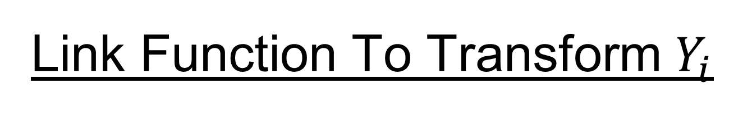
Link Function To Transform $Y_{i}$
$g\left(E\left(Y_{i}\right)\right)=β_{1}x_{1i}+β_{2i}x_{2i}+…$
  Linear model without the error
$g$ is a “link” function
$E\left(Y_{i}\right)$ = $g^{−1}(β_{1}x_{1i}+β_{2i}x_{2i}+…$)

Slide 12
Common Functions in R
Error Distribution (Link Function)
Binomial (link = "logit")
  True/false, alive/dead, present/absent
Gaussian (link = "identity")
  Continuous, normal
Gamma (link = "inverse")
  Seed distribution, distance from…
Poisson (link = "log")
  Counts

Slide 13
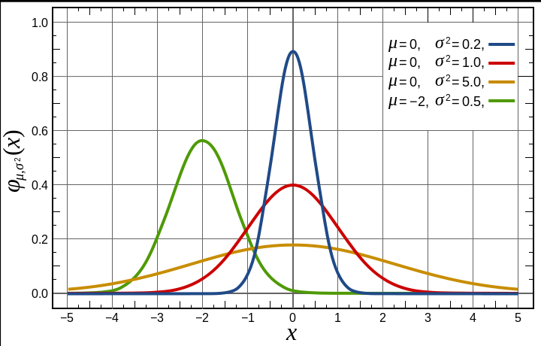
Gaussian Distribution
AKA “Gaussian” Distribution
Wikipedia

Slide 14
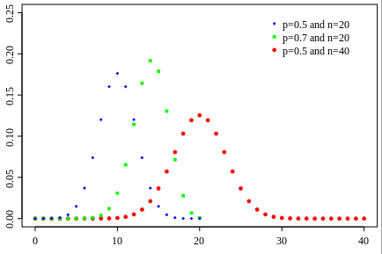
Binomial
Number of successes of yes/no experiments
Wikipedia

Slide 15
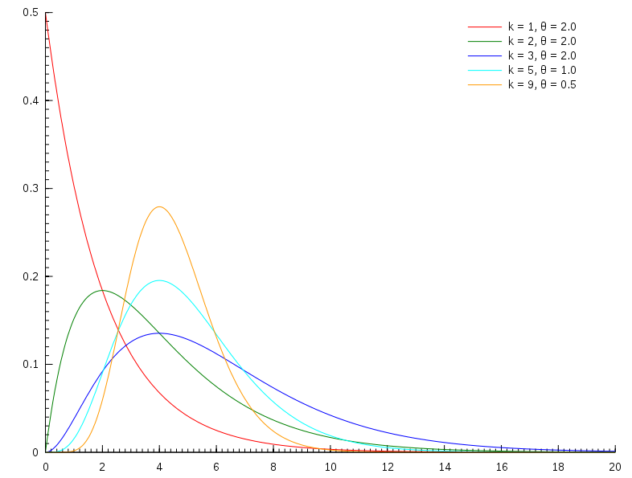
Gamma Distribution
Wait times, seed distribution, etc.
Wikipedia

Slide 16
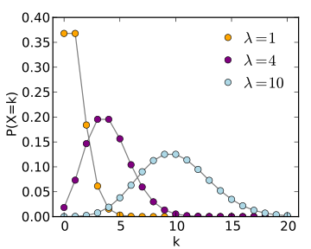
Poisson
Number of events in time T, k=number of occurrences
Wikipedia

